Slide 1

MASTER THE TIDYVERSE
Mike K Smith
Winter 2020
Materials used in this course are derived from
https://github.com/rstudio-education/master-the-tidyverse/
and are shared under a CC-BY-SA-4.0 license.

Slide 2


HELLO
my name is
Mike
 @MikeKSmith
MikeKSmith
Mike.K.Smith@Pfizer.com
CC BY-SA RStudio
Notes:
* introduce yourself

Slide 3
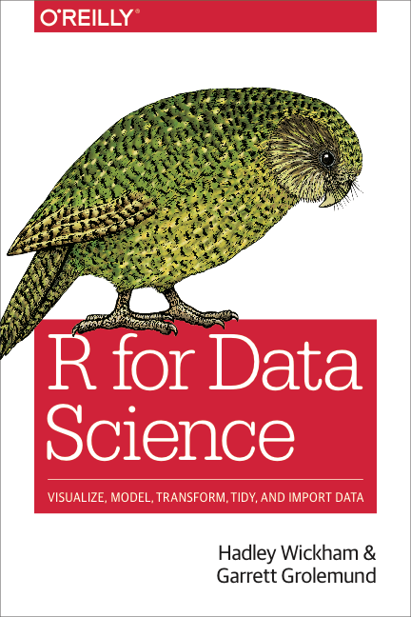
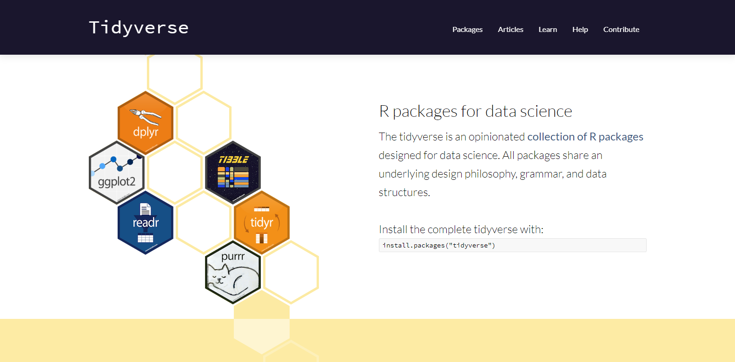
http://tidyverse.org
https://r4ds.had.co.nz/
CC BY-SA RStudio

Slide 4
Introduction and Visualize Data | 17th Jan
Transforming (subsetting) data | 24th Jan
Importing and reshaping data | 31st Jan
Data Types: strings, factors, date-times | 7th Feb
Iteration & Modelling | 14th Feb
Reproducible reporting | 21st Feb
CC BY-SA RStudio

Slide 5
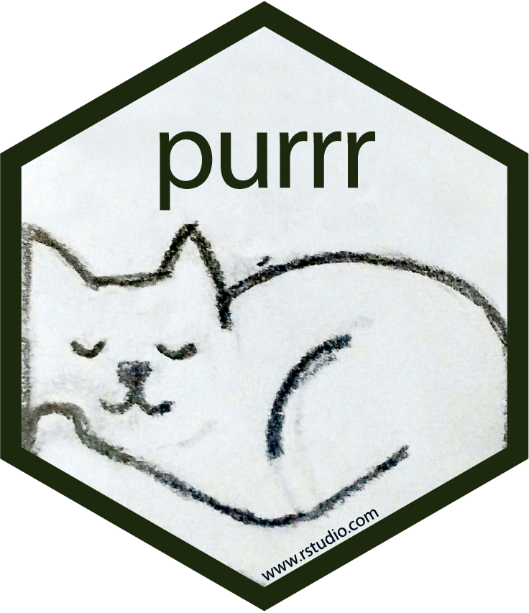
Iteration with

Slide 6
loops
works with
alternatively
Iteration
R objects
alternatively
uses
type of
works with
apply
purrr::map
lists
uses
uses
functions

Slide 7

R object types (a brief scamper)

Slide 8

Vector
type
Must have consistent types
CC BY-SA RStudio

Slide 9
Vector
"one"
"two"
"three"
character
myVector <- c("one", "two", "three")
CC BY-SA RStudio

Slide 10
Vector
1
2
3
double
myVector <- c(1, 2, 3)
CC BY-SA RStudio

Slide 11
Vector
TRUE
FALSE
FALSE
logical
myVector <- c(TRUE, FALSE, FALSE)
CC BY-SA RStudio

Slide 12
Scalar
type
Vector with length = 1
myScalar <- 1
myScalar <- myVector[1]
R indices start at 1
Extract elements with [ ]
CC BY-SA RStudio

Slide 13
Vector
CC BY-SA RStudio

Slide 14
Matrix
1
3
5
2
4
6
Vector with dimensions: rows, columns
myVector <- c(1,2,3,4,5,6)
myMatrix <- matrix(myVector, nrow=2, ncol=3)
CC BY-SA RStudio

Slide 15
Matrix
1
2
3
4
5
6
Vector with dimensions: rows, columns
myVector <- c(1,2,3,4,5,6)
myMatrix <- matrix(myVector, nrow=2, ncol=3, byrow=TRUE)
CC BY-SA RStudio

Slide 16
Array
Vector with >= 2 dimensions
myVector <- c(1,2,3,4,5,6)
myArray <- array(myVector, dim=c(2,3))
CC BY-SA RStudio

Slide 17
Vector
1
"one"
FALSE
?
CC BY-SA RStudio

Slide 18
Vector
"1"
"one"
"FALSE"
character
CC BY-SA RStudio

Slide 19


Vector
1
"one"
FALSE
List
1
double
1
"one"
character
FALSE
logical
CC BY-SA RStudio

Slide 20
List
data frame
num | cha | log
1 | "one" | TRUE
2 | "two" | FALSE
3 | "three" | FALSE
1
2
3
double
=
"one"
"two"
"three"
character
TRUE
FALSE
FALSE
logical
+ class = "data.frame"
CC BY-SA RStudio

Slide 21
data frame
df["num"]
df[["num"]]
num | cha | log
1 | "one" | TRUE
2 | "two" | FALSE
3 | "three" | FALSE
num
1
2
3
df$num
c(1, 2, 3)
CC BY-SA RStudio

Slide 22
List
1
double
1
"1"
"two"
"FALSE"
character
FALSE
logical
CC BY-SA RStudio

Slide 23
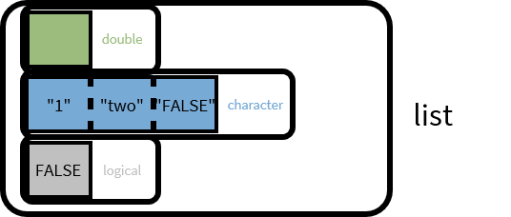
List
1
double
1
"1"
"two"
"FALSE"
character
1
double
list
"1"
"two"
"FALSE"
character
It's lists all the way down
double
"1"
"two"
"FALSE"
character
list
CC BY-SA RStudio

Slide 24
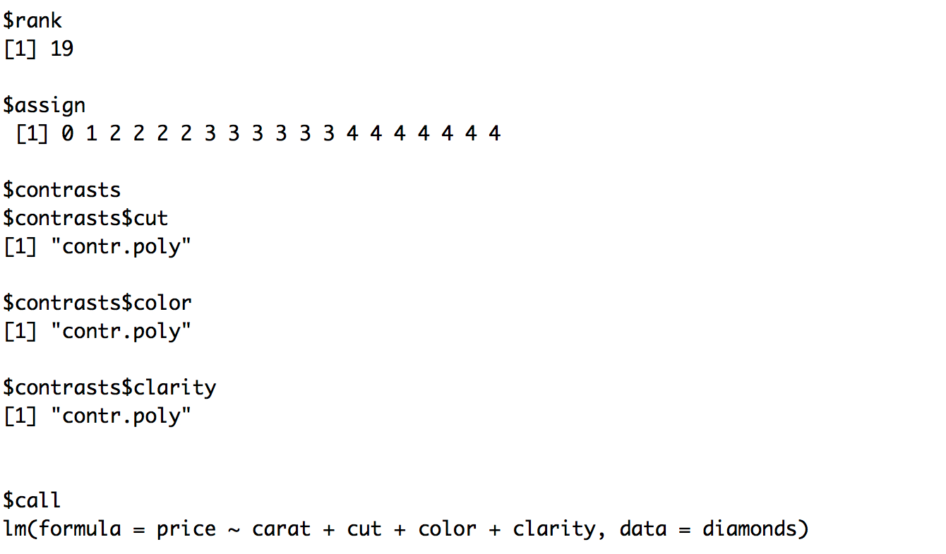
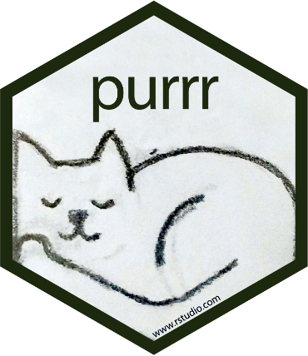
Partial output of fitting the linear model
lm(price ~ carat + cut + color + clarity, data = diamonds)
CC BY-SA RStudio

Slide 25
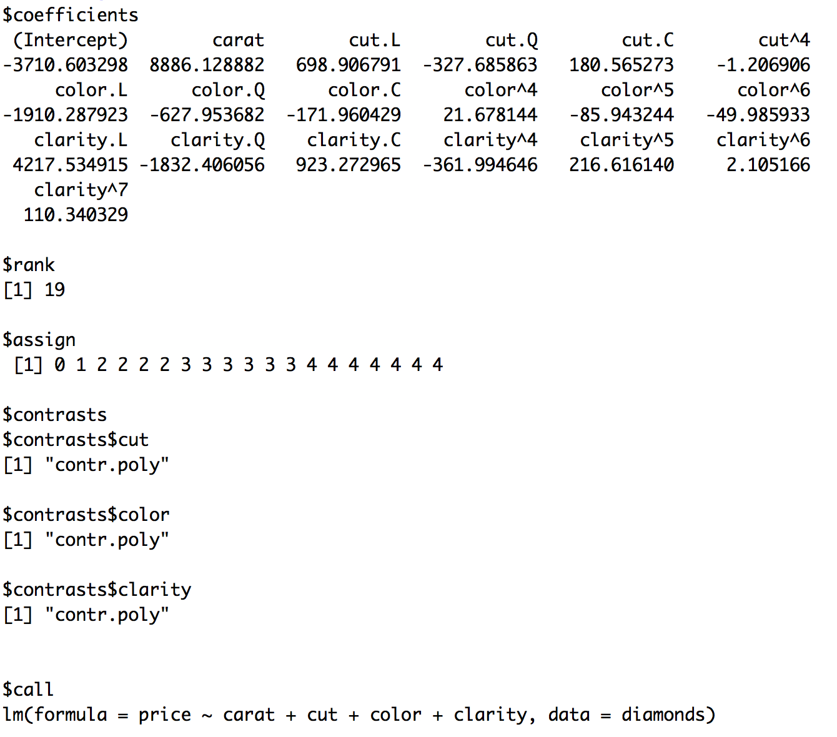
CC BY-SA RStudio

Slide 26
More detail
http://adv-r.had.co.nz/Data-structures.html

Slide 27
Your Turn 1
Here is a list:
a_list <- list(num = c(8, 9),
log = TRUE,
cha = c("a", "b", "c"))
Here are two subsetting commands. Do they return the same values? Run the code chunks to confirm
a_list["num"]
a_list$num

Slide 28
a_list["num"]
$num
[1] 8 9
A list
(with one element named num that contains an atomic vector)
a_list$num
[1] 8 9
An atomic vector
CC BY-SA RStudio

Slide 29
num
log
cha
lst
c(8, 9)
TRUE
c("a", "b", "c")
lst <- list(num = c(8,9), log = TRUE, cha = c("a", "b", "c"))
CC BY-SA RStudio

Slide 30
num
log
cha
c(8, 9)
TRUE
c("a", "b", "c")
num
c(8, 9)
lst["num"]
CC BY-SA RStudio

Slide 31
num
log
cha
c(8, 9)
TRUE
c("a", "b", "c")
num
c(8, 9)
lst["num"]
lst[["num"]]
c(8, 9)
CC BY-SA RStudio

Slide 32
num
log
cha
c(8, 9)
TRUE
c("a", "b", "c")
num
c(8, 9)
lst["num"]
lst[["num"]]
c(8, 9)
lst$num
c(8, 9)
CC BY-SA RStudio

Slide 33
Your Turn 2
What will each of these return? Run the code chunks to confirm.
vec <- c(-2, -1, 0, 1, 2)
abs(vec)
lst <- list(-2, -1, 0, 1, 2)
abs(lst)
# 2 1 0 1 2
# Error in abs(lst) :
# non-numeric argument to mathematical function

Slide 34
Take aways
Lists are a useful way to organize data.
But you need to arrange manually for functions to iterate over the elements of a list.
CC BY-SA RStudio

Slide 35
Iteration

Slide 36
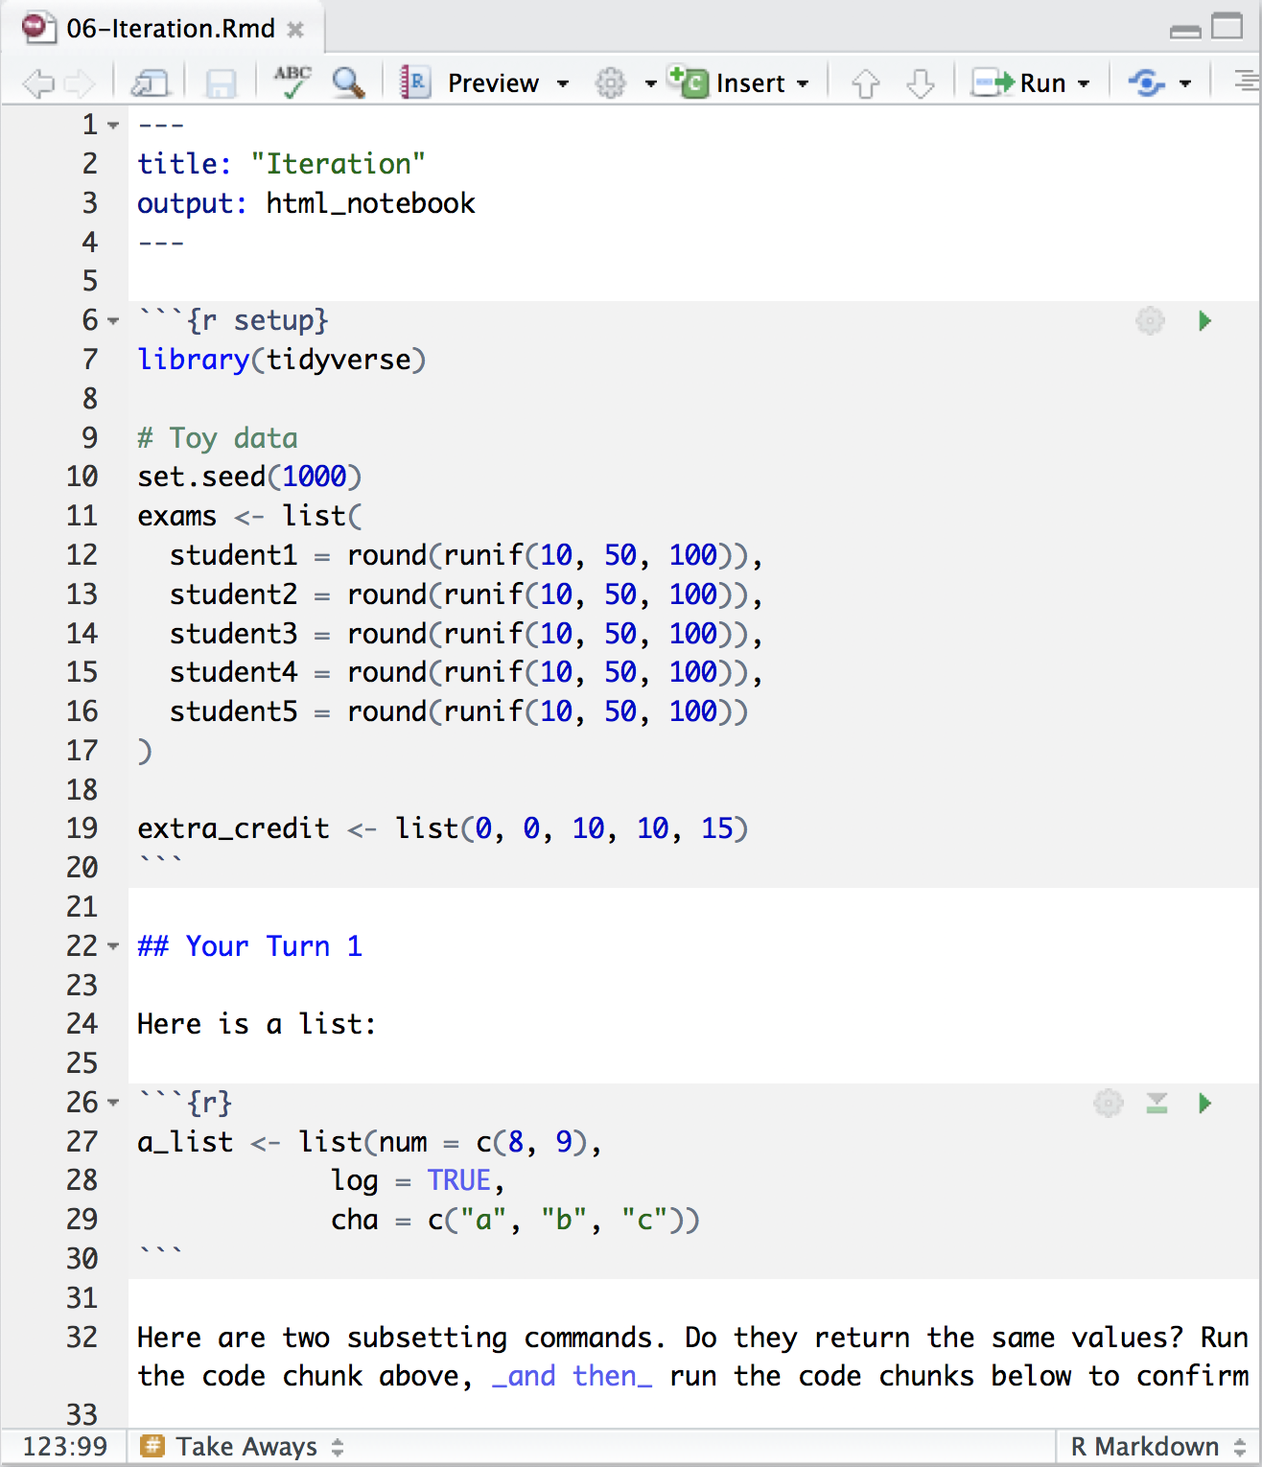
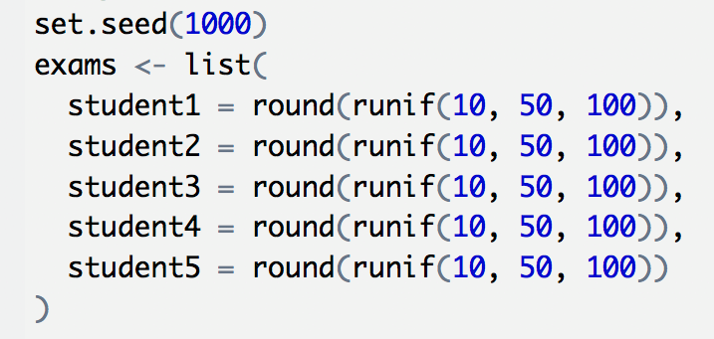
Toy data
Suppose we have the exam scores of five students…
Ensures that you
and I generate the same "random" values
CC BY-SA RStudio

Slide 37
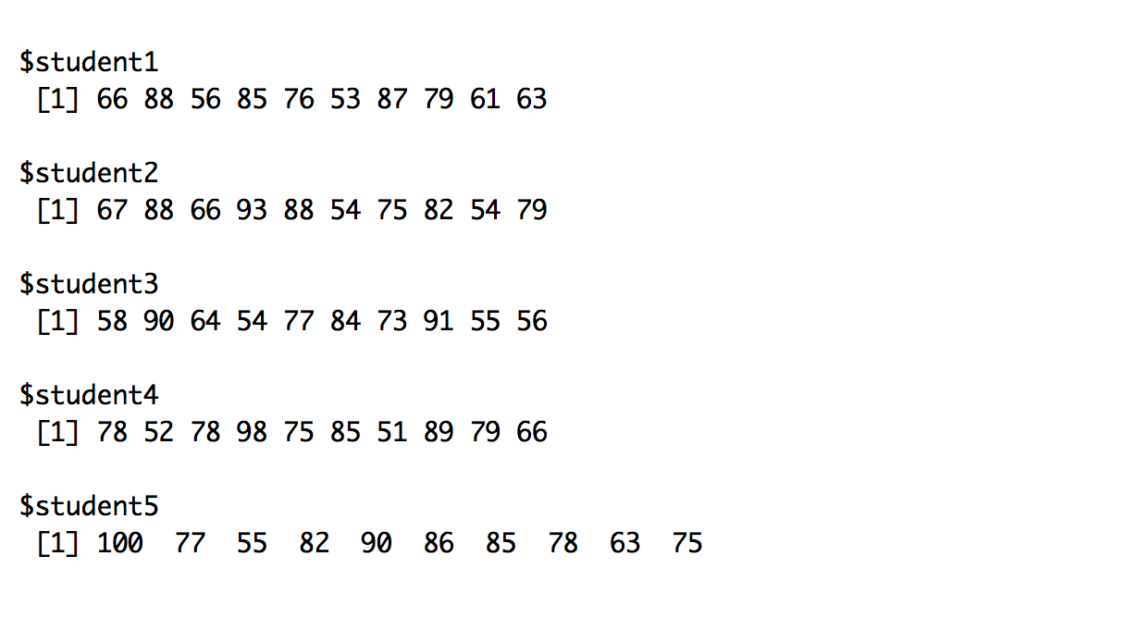
Suppose we have the exam scores of five students…
exams
How can we compute the mean grade for each student?
CC BY-SA RStudio

Slide 38
How could we compute the average grade?
mean(exams)
CC BY-SA RStudio

Slide 39
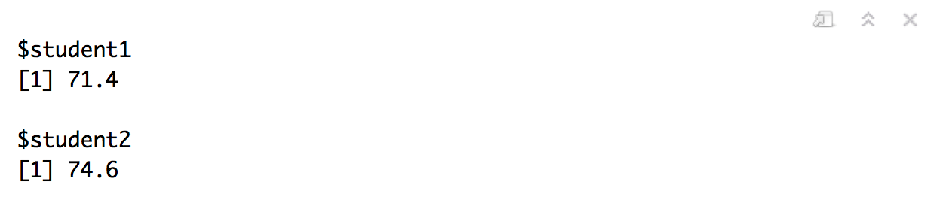
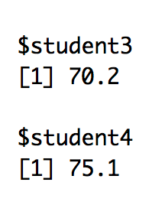
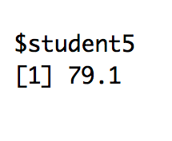
How could we compute the average grade?
list(student1 = mean(exams$student1),
student2 = mean(exams$student2),
student3 = mean(exams$student3),
student4 = mean(exams$student4),
student5 = mean(exams$student5))
CC BY-SA RStudio

Slide 40
loops

Slide 41
loops
works with
alternatively
YOU ARE HERE
Iteration
R objects
alternatively
uses
type of
works with
apply
purrr::map
lists
uses
uses
functions

Slide 42
for loops
output <- vector("double", ncol(df)) # 1. output
for (i in seq_along(exams)) { # 2. sequence
output[[i]] <- mean(exams[[i]]) # 3. body
}
output
seq_along is equivalent to 1:length( )
CC BY-SA RStudio

Slide 43
for loops
output <- vector("double", ncol(df)) # 1. output
for (i in seq_along(exams)) { # 2. sequence
output[[i]] <- mean(exams[[i]]) # 3. body
}
output
All loops have three components:
The output (where the answers will be stored)
The sequence (how many iterations do we do?)
The body (what to do to each item?)
CC BY-SA RStudio

Slide 44
for loops - CAUTION
means <- c(0, 1, 2)
output <- double()
for (i in seq_along(means)) {
n <- sample(100, 1)
output <- c(output, rnorm(n, means[[i]]))
}
str(output)
#> num [1:202] 0.912 0.205 2.584 -0.789 0.588 ...
Here we are growing output with each iteration i.e. appending the iteration body values to the output vector. This is inefficient. R has to copy all the data from previous iterations.
CC BY-SA RStudio

Slide 45
apply
(and friends)

Slide 46
loops
works with
alternatively
YOU ARE HERE
Iteration
R objects
alternatively
uses
type of
works with
apply
purrr::map
lists
uses
uses
functions

Slide 47
apply
library(tidyverse)
myArray <- runif(1000) %>%
array(., dim=c(100,10))
myArray
#> [,1] [,2] [,3] [,4] [,5] [,6]
#> [1,] 0.20024318 0.4084925761 0.06942847 0.3863526 0.2548945 0.574614474
#> [2,] 0.55825306 0.1337873812 0.94822404 0.4320701 0.7510811 0.962137008
#> [3,] 0.73313271 0.2478848572 0.28047156 0.5987072 0.6392563 0.904404768
apply(myArray, MARGIN = 2, FUN = mean)
#> [1] 0.4832346 0.4768975 0.4667340 0.5218000 0.5063612 0.5212301 0.4949168
#> [8] 0.5572895 0.4819968 0.4845785
CC BY-SA RStudio

Slide 48
Suppose we have the exam scores of five students…
exams
How can we compute the mean grade for each student?
CC BY-SA RStudio

Slide 49
lapply – apply for lists
lapply(exams, FUN = mean)
#> $student1
#> [1] 71.4
#>
#> $student2
#> [1] 74.6
#>
#> $student3
#> [1] 70.2
#>
#> $student4
#> [1] 75.1
#>
#> $student5
#> [1] 79.1
CC BY-SA RStudio

Slide 50
sapply – simplifying lapply output
sapply(exams, FUN = mean)
#> student1 student2 student3 student4 student5
#> 71.4 74.6 70.2 75.1 79.1
a vector
CC BY-SA RStudio

Slide 51
tapply –lapply with an indexing variable
exams <- data.frame(exams) %>%
pivot_longer(cols=1:5, names_to="student", values_to="result")
tapply(exams$result, INDEX = list(exams$student), FUN = mean)
#> student1 student2 student3 student4 student5
#> 71.4 74.6 70.2 75.1 79.1
has to be a list
CC BY-SA RStudio

Slide 52
apply
lapply
sapply
tapply
mapply
vapply
by
aggregate
sweep
…
What is the input object type?
What is the output object type?
What do they take as arguments?

Slide 53
purrr

Slide 54
loops
works with
alternatively
YOU ARE HERE
Iteration
R objects
alternatively
uses
type of
works with
apply
purrr::map
lists
uses
uses
functions

Slide 55
How could we compute the average grade?
list(student1 = mean(exams$student1),
student2 = mean(exams$student2),
student3 = mean(exams$student3),
student4 = mean(exams$student4),
student5 = mean(exams$student5))
Is there a better way?
CC BY-SA RStudio

Slide 56
purrr
Functions for working with lists.
# install.packages("tidyverse")
library(tidyverse)
CC BY-SA RStudio

Slide 57

Your Turn 3
Run the code in the chunk. What does it do?
map(exams, mean)

Slide 58
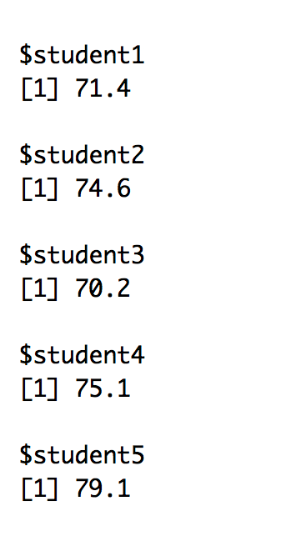
exams %>% map(mean)
CC BY-SA RStudio

Slide 59
map()
Applies a function to every element of a list.
Returns the results as a list.
map(.x, .f, …)
A list
A function to apply to each element of the list
(element become first argument)
Other arguments to pass to the function
CC BY-SA RStudio

Slide 60
map()
map(
exams
$student1
$student2
$student3
$student4
$student5
, mean, …)
exams
$student1
$student2
$student3
$student4
$student5
list
result1
result2
result3
result4
result5
mean(
, …)
mean(
, …)
mean(
, …)
mean(
, …)
mean(
, …)
CC BY-SA RStudio

Slide 61
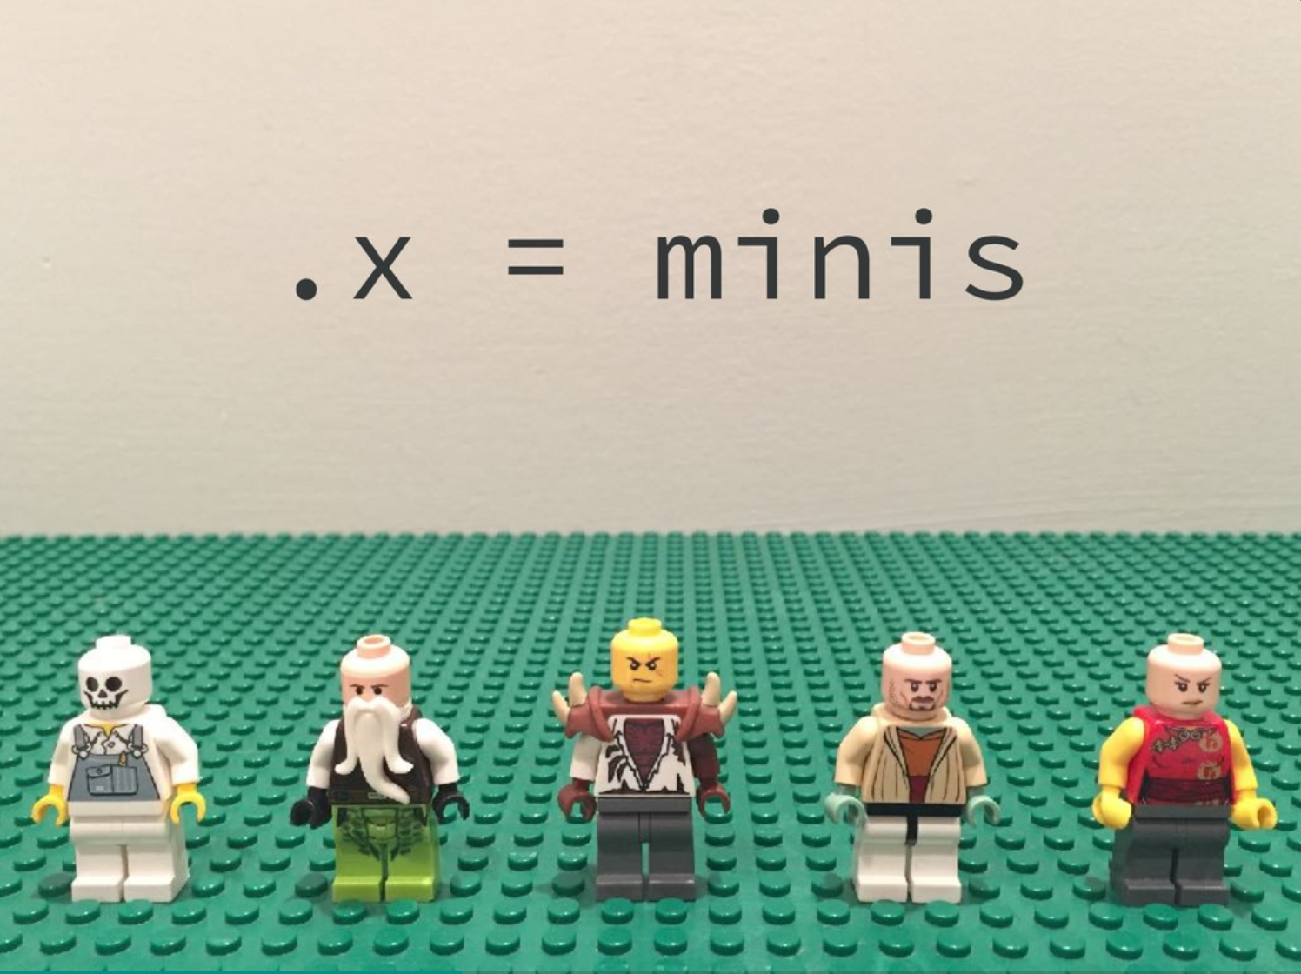
https://speakerdeck.com/jennybc/purrr-workshop

Slide 62
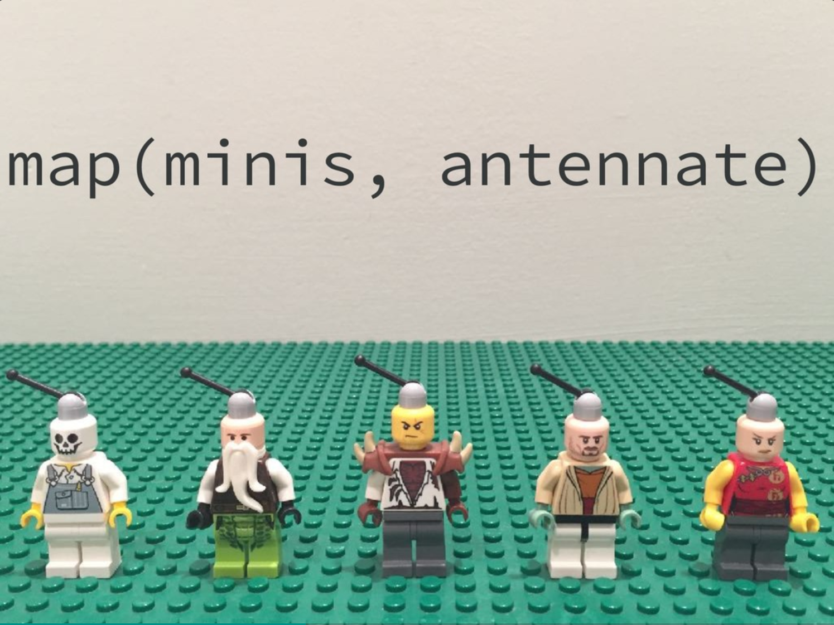
https://speakerdeck.com/jennybc/purrr-workshop

Slide 63
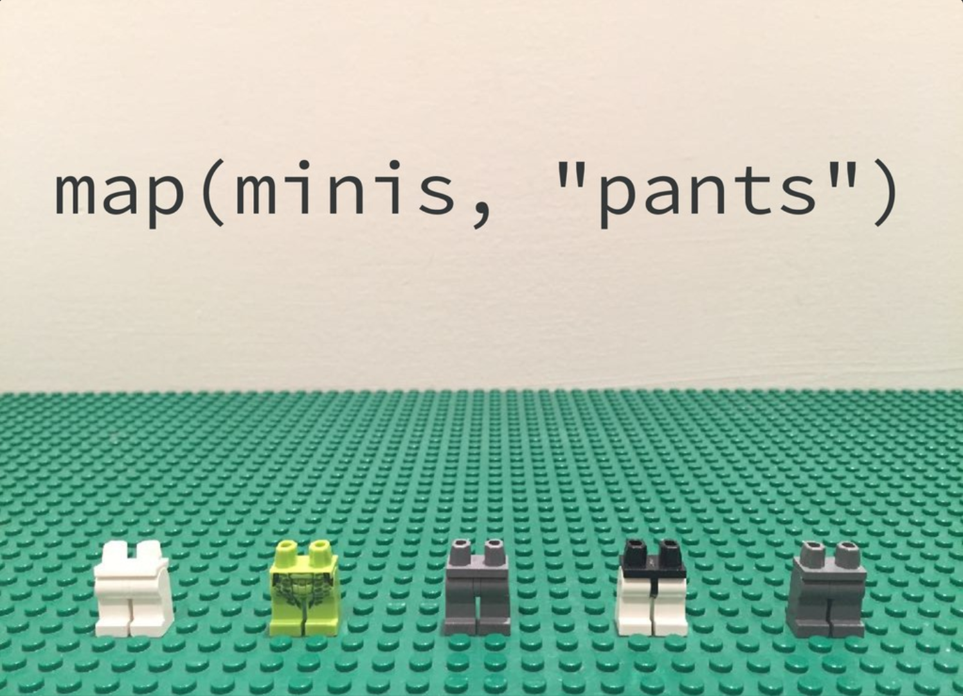
https://speakerdeck.com/jennybc/purrr-workshop

Slide 64
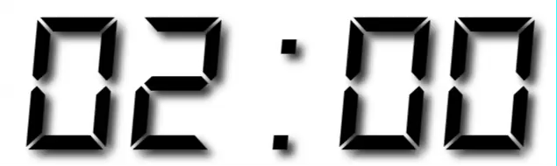
Your Turn 4
Calculate the variance (var()) of each student’s exam grades.

Slide 65
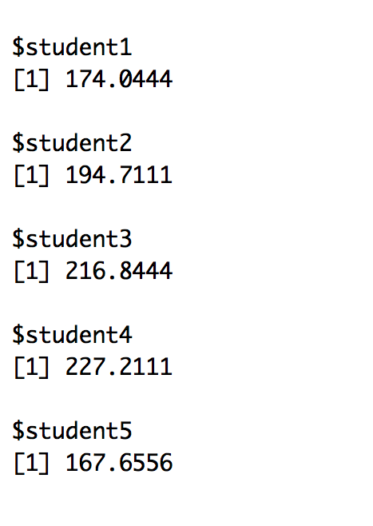
exams %>% map(var)
CC BY-SA RStudio

Slide 66
map functions
function | returns results as
map() | list
map_chr() | character vector
map_dbl() | double vector (numeric)
map_int() | integer vector
map_lgl() | logical vector
map_df() | data frame
CC BY-SA RStudio

Slide 67
map_dbl()
If we want the output as a vector:
exams %>%
map_dbl(mean)
## student1 student2 student3 student4 student5
## 71.34850 74.60950 70.21575 75.30758 79.06386
CC BY-SA RStudio

Slide 68
extra arguments
What if the grade was the 90th percentile score?
exams %>%
map_dbl(quantile, prob = 0.9)
## student1 student2 student3 student4 student5
## 87.03640 88.71630 90.34335 90.09150 90.88785
extra argument for quantile
CC BY-SA RStudio

Slide 69
map_lgl()
How about a participation grade?
exams %>%
map(length) %>%
map_lgl(all.equal, 10)
## student1 student2 student3 student4 student5
## TRUE TRUE TRUE TRUE TRUE
CC BY-SA RStudio

Slide 70
Your Turn 5
Calculate the max grade (max())for each student. Return the result as a vector.

Slide 71
exams %>%
map_dbl(max)
## student1 student2 student3 student4 student5
## 88 93 91 98 100
CC BY-SA RStudio

Slide 72
Sometimes you won't need to map over a list…

Slide 73
exams1 <- data.frame(
student1 = round(runif(10, 50, 100)),
student2 = round(runif(10, 50, 100)),
student3 = round(runif(10, 50, 100)),
student4 = round(runif(10, 50, 100)),
student5 = round(runif(10, 50, 100))
)
exams2 <- data.frame(
student1 = round(runif(10, 50, 100)),
student2 = round(runif(10, 50, 100)),
student3 = round(runif(10, 50, 100)),
student4 = round(runif(10, 50, 100)),
student5 = round(runif(10, 50, 100))
)
exams <- list(exams1, exams2)
data.frame( ) NOT list( )
List of data.frame( )
CC BY-SA RStudio

Slide 74
collapse a list into a data frame and identify the contributing list element by name
exams <- exams %>%
map_dfr(I, .id="Exam")
exams
#> Exam student1 student2 student3 student4 student5
#> 1 1 66 67 58 78 100
#> 2 1 88 88 90 52 77
#> 3 1 56 66 64 78 55
#> 4 1 85 93 54 98 82
#> 5 1 76 88 77 75 90
#> 6 1 53 54 84 85 86
#> 7 1 87 75 73 51 85
#> 8 1 79 82 91 89 78
#> 9 1 61 54 55 79 63
#> 10 1 63 79 56 66 75
#> 11 2 86 71 79 65 96
#> 12 2 84 51 86 59 91
#> 13 2 52 88 68 96 80
#> 14 2 76 98 71 53 51
#> 15 2 82 62 93 79 77
CC BY-SA RStudio

Slide 75
exams %>%
pivot_longer(cols = starts_with("student"),
names_to = "student",
values_to = "result") %>%
group_by(student) %>%
summarise(mean = mean(result))
#> # A tibble: 5 x 2
#> student mean
#> <chr> <dbl>
#> 1 student1 75.4
#> 2 student2 75.7
#> 3 student3 69.4
#> 4 student4 72.0
#> 5 student5 76.8
CC BY-SA RStudio

Slide 76
But I don’t have a list, I have a tibble (or data frame)…

Slide 77
exams <- exams %>%
map_dfr(I, .id="Exam")
exams
#> Exam student1 student2 student3 student4 student5
#> 1 1 66 67 58 78 100
#> 2 1 88 88 90 52 77
#> 3 1 56 66 64 78 55
#> 4 1 85 93 54 98 82
#> 5 1 76 88 77 75 90
#> 6 1 53 54 84 85 86
#> 7 1 87 75 73 51 85
#> 8 1 79 82 91 89 78
#> 9 1 61 54 55 79 63
#> 10 1 63 79 56 66 75
#> 11 2 86 71 79 65 96
#> 12 2 84 51 86 59 91
#> 13 2 52 88 68 96 80
#> 14 2 76 98 71 53 51
#> 15 2 82 62 93 79 77
CC BY-SA RStudio

Slide 78
exams %>%
group_by(Exam) %>%
group_split()
#> [[1]]
#> # A tibble: 10 x 6
#> Exam student1 student2 student3 student4 student5
#> <chr> <dbl> <dbl> <dbl> <dbl> <dbl>
#> 1 1 66 67 58 78 100
#> 2 1 88 88 90 52 77
#>
#> [[2]]
#> # A tibble: 10 x 6
#> Exam student1 student2 student3 student4 student5
#> <chr> <dbl> <dbl> <dbl> <dbl> <dbl>
#> 1 2 86 71 79 65 96
#> 2 2 84 51 86 59 91
#>
#> attr(,"ptype")
#> # A tibble: 0 x 6
#> # ... with 6 variables: Exam <chr>, student1 <dbl>, student2 <dbl>,
#> # student3 <dbl>, student4 <dbl>, student5 <dbl>
CC BY-SA RStudio

Slide 79
Quiz
How would we map a function over column contents in a given row?
A: Use mutate( … )

Slide 80
Functions

Slide 81
loops
works with
alternatively
Iteration
R objects
alternatively
uses
type of
works with
apply
purrr::map
lists
YOU ARE HERE
uses
uses
functions

Slide 82
Quiz
What if what we want to do is not a function?
For example, what if the final grade is the mean exam score after we drop the lowest score?
A: Write our own function.

Slide 83
Functions (very basics)
1. Write code that solves the problem for a real object
vec <- exams$student1
CC BY-SA RStudio

Slide 84
To write a function (very basics)
1. Write code that solves the problem for a real object
vec <- exams$student1
(sum(vec) - min(vec)) / (length(vec) - 1)
# 73.34424
CC BY-SA RStudio

Slide 85
Note: this code does the same thing no matter what vec is.
But it is a bother to redefine vec each time we use the code.
vec <- exams$student1
(sum(vec) - min(vec)) / (length(vec) - 1)
vec <- exams$student2
(sum(vec) - min(vec)) / (length(vec) - 1)
vec <- exams$student3
(sum(vec) - min(vec)) / (length(vec) - 1)
vec <- exams$student4
(sum(vec) - min(vec)) / (length(vec) - 1)
vec <- exams$student5
(sum(vec) - min(vec)) / (length(vec) - 1)
CC BY-SA RStudio

Slide 86
ALSO: If you write (essentially the same) code >3 times, you should write a function…
vec <- exams$student1
(sum(vec) - min(vec)) / (length(vec) - 1)
vec <- exams$student2
(sum(vec) - min(vec)) / (length(vec) - 1)
vec <- exams$student3
(sum(vec) - min(vec)) / (length(vec) - 1)
vec <- exams$student4
(sum(vec) - min(vec)) / (length(vec) - 1)
vec <- exams$student5
(sum(vec) - min(vec)) / (length(vec) - 1)
CC BY-SA RStudio

Slide 87
To write a function (very basics)
1. Write code that solves the problem for a real object
2. Wrap the code in function(){} to save it
vec <- exams[[1]]
grade <- function() {
(sum(vec) - min(vec)) / (length(vec) - 1)
}
CC BY-SA RStudio

Slide 88
To write a function (very basics)
1. Write code that solves the problem for a real object
2. Wrap the code in function(){} to save it
3. Add the name of the real object as the function argument
vec <- exams[[1]]
grade <- function(vec) {
(sum(vec) - min(vec)) / (length(vec) - 1)
}
CC BY-SA RStudio

Slide 89
To write a function (very basics)
1. Write code that solves the problem for a real object
2. Wrap the code in function(){} to save it
3. Add the name of the real object as the function argument
4. To run the function, call the object followed by parentheses.
Supply new values to use for each of the arguments.
vec <- exams[[1]]
grade <- function(vec) {
(sum(vec) - min(vec)) / (length(vec) - 1)
}
grade(exams[[2]]) # 76.93898
CC BY-SA RStudio

Slide 90
grade <- function(vec) {
(sum(vec) - min(vec)) / (length(vec) - 1)
}
exams %>%
map_dbl(grade)
## student1 student2 student3 student4 student5
## 73.34424 76.93898 72.06320 78.00649 81.68257
CC BY-SA RStudio

Slide 91
grade <- function(x) {
(sum(x) - min(x)) / (length(x) - 1)
}
exams %>%
map_dbl(grade)
## student1 student2 student3 student4 student5
## 73.34424 76.93898 72.06320 78.00649 81.68257
CC BY-SA RStudio

Slide 92
grade <- function(x) (sum(x) - min(x)) / (length(x) - 1)
exams %>%
map_dbl(grade)
## student1 student2 student3 student4 student5
## 73.34424 76.93898 72.06320 78.00649 81.68257
CC BY-SA RStudio

Slide 93
grade <- function(x) (sum(x) - min(x)) / (length(x) - 1)
exams %>%
map_dbl(function(x) (sum(x) - min(x)) / (length(x) - 1))
## student1 student2 student3 student4 student5
## 73.34424 76.93898 72.06320 78.00649 81.68257
CC BY-SA RStudio

Slide 94
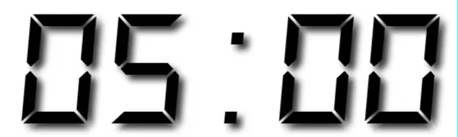
Your Turn 6
Write a function that counts the best exam twice and then takes the average. Use it to grade all of the students.
1. Write code that solves the problem for a real object
2. Wrap the code in function(){} to save it
3. Add the name of the real object as the function argument

Slide 95
exams %>%
map_dbl(function(x) (sum(x) + max(x)) / (length(x) + 1))
## student1 student2 student3 student4 student5
## 72.85703 76.30779 72.12398 77.39862 80.94991
CC BY-SA RStudio

Slide 96
Debugging functions
https://adv-r.hadley.nz/debugging.html
https://bookdown.org/rdpeng/RProgDA/debugging.html
https://support.rstudio.com/hc/en-us/articles/205612627-Debugging-with-RStudio

Slide 97
Quiz
What does this return?
add_1 <- function(x) x + 1
add_1(1)

Slide 98
Quiz
What does this return?
add_1 <- function(x) x + 1
add_1(1)
# 2

Slide 99
Quiz
What does this return?
add_2 <- function(x, y) x + y
add_2(2, 3)

Slide 100
Quiz
What does this return?
add_2 <- function(x, y) x + y
add_2(2, 3)
# 5
If functions can take two arguments, how can you pass two lists as the arguments?

Slide 101
map2()
Applies a function to every element of two lists.
Returns the results as a list.
map2(.x, .y, .f, …)
A list of elements to pass to the first argument of .f
A list of elements to pass to the second argument of .f
CC BY-SA RStudio

Slide 102
map2()
map2(
exams
$student1
$student2
$student3
$student4
$student5
,
extra
$extra1
$extra2
$extra3
$extra4
$extra5
, fun, …)
exams
$student1
$student2
$student3
$student4
$student5
extra
$extra1
$extra2
$extra3
$extra4
$extra5
list
result1
result2
result3
result4
result5
fun(
,
, …)
fun(
,
, …)
fun(
,
, …)
fun(
,
, …)
fun(
,
, …)
CC BY-SA RStudio

Slide 103
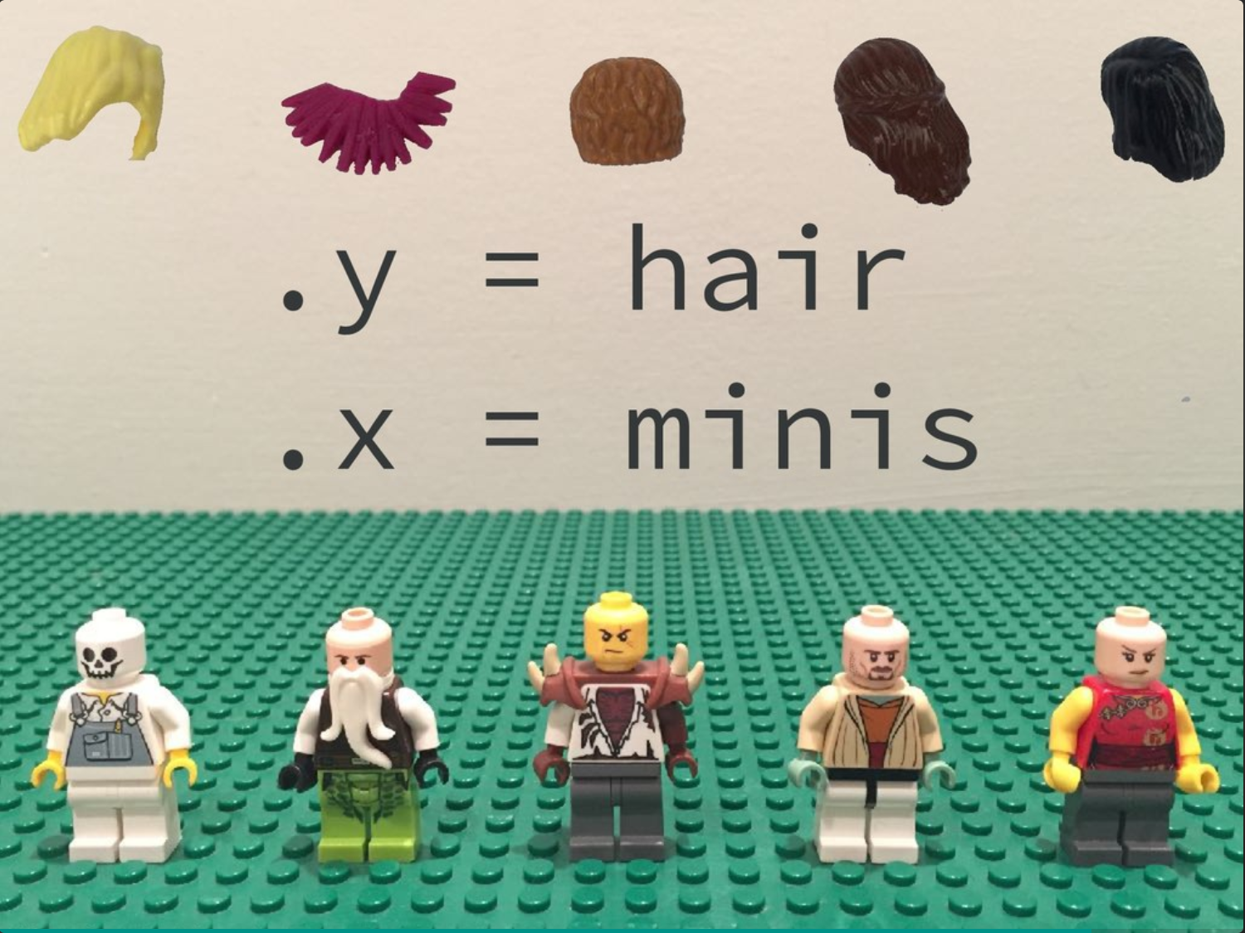
https://speakerdeck.com/jennybc/purrr-workshop

Slide 104
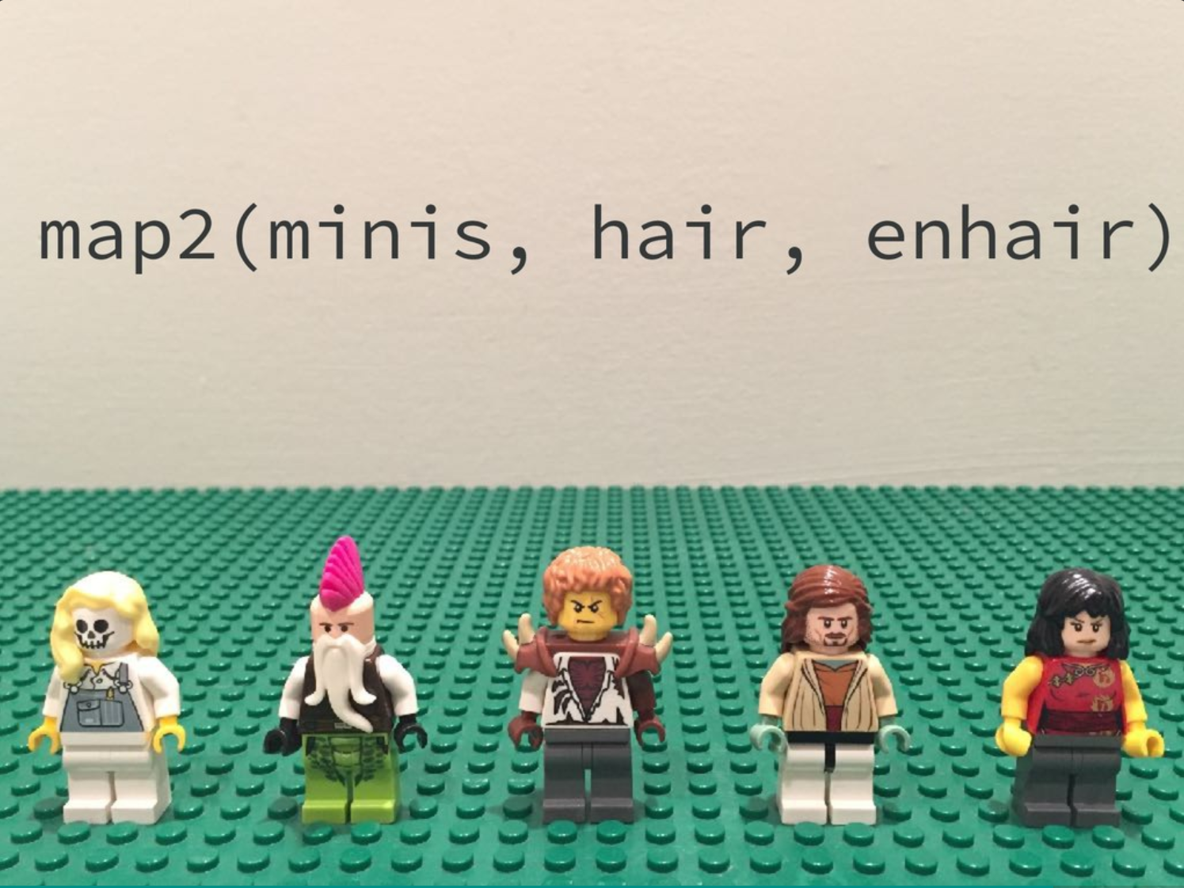
https://speakerdeck.com/jennybc/purrr-workshop

Slide 105
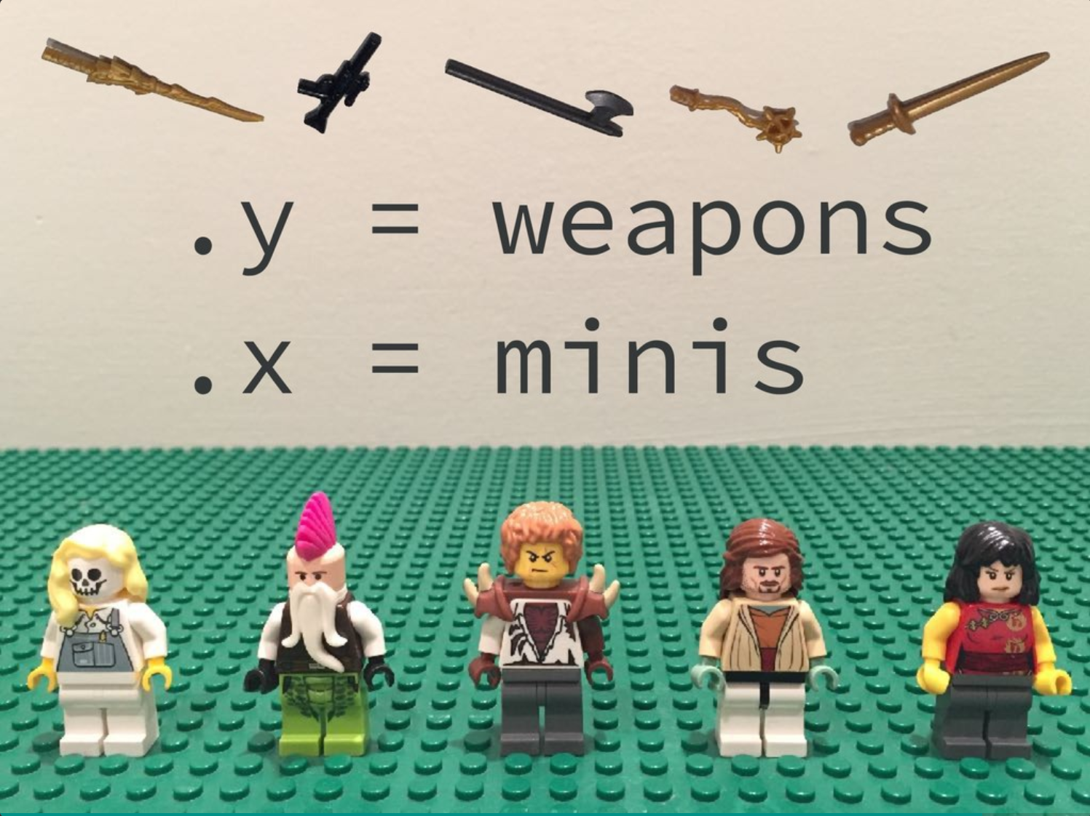
https://speakerdeck.com/jennybc/purrr-workshop

Slide 106
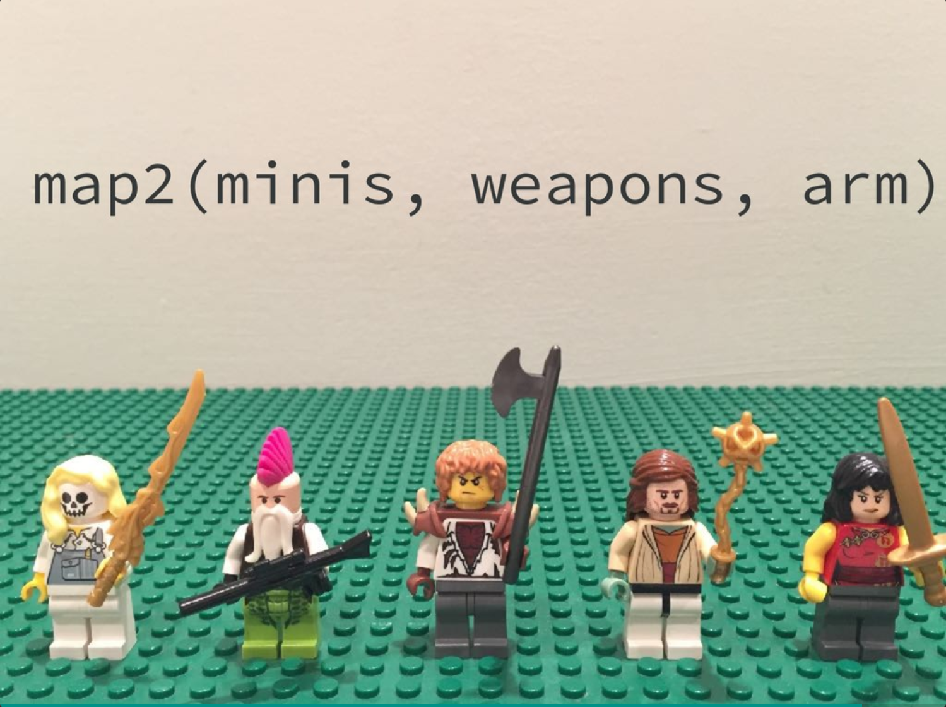
https://speakerdeck.com/jennybc/purrr-workshop

Slide 107
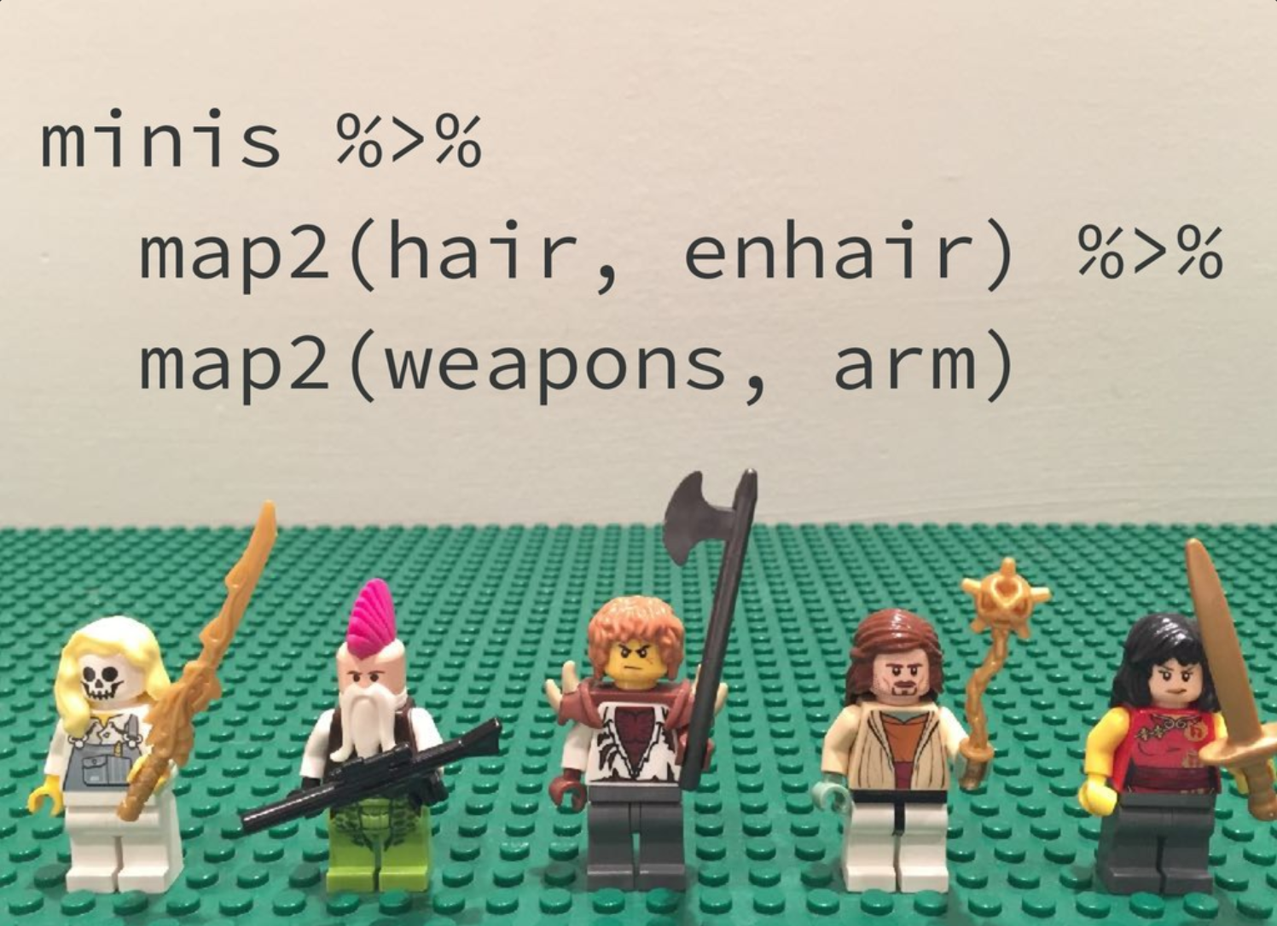
https://speakerdeck.com/jennybc/purrr-workshop

Slide 108
map functions
single list | two lists | returns results as
map() | map2() | list
map_chr() | map2_chr() | character vector
map_dbl() | map2_dbl() | double vector (numeric)
map_int() | map2_int() | integer vector
map_lgl() | map2_lgl() | logical vector
map_df() | map2_df() | data frame
CC BY-SA RStudio

Slide 109
Toy data
Suppose we have extra credit for the five students…
CC BY-SA RStudio

Slide 110
Your Turn 7
Compute a final grade for each student, where the final grade is the average test score plus any extra credit assigned to the student. Return the results as a double (i.e. numeric) vector.

Slide 111
The grades with extra credit…
exams %>%
map2_dbl(extra_credit, function(x, y) mean(x) + y)
## student1 student2 student3 student4 student5
## 71.4 74.6 80.2 85.1 94.1
CC BY-SA RStudio

Slide 112
Other mapping functions

Slide 113
pmap()
Map over three or more lists. Put the lists into a list of list whose names match argument names in the function.
pmap(list(
exams
$student1
$student2
$student3
$student4
$student5
,
extra
$extra1
$extra2
$extra3
$extra4
$extra5
,
more
$more1
$more2
$more3
$more4
$more5
), fun, …)
exams
$student1
$student2
$student3
$student4
$student5
extra
$extra1
$extra2
$extra3
$extra4
$extra5
more
$more1
$more2
$more3
$more4
$more5
fun(
,
,
, …)
fun(
,
,
, …)
fun(
,
,
, …)
fun(
,
,
, …)
fun(
,
,
, …)
CC BY-SA RStudio

Slide 114
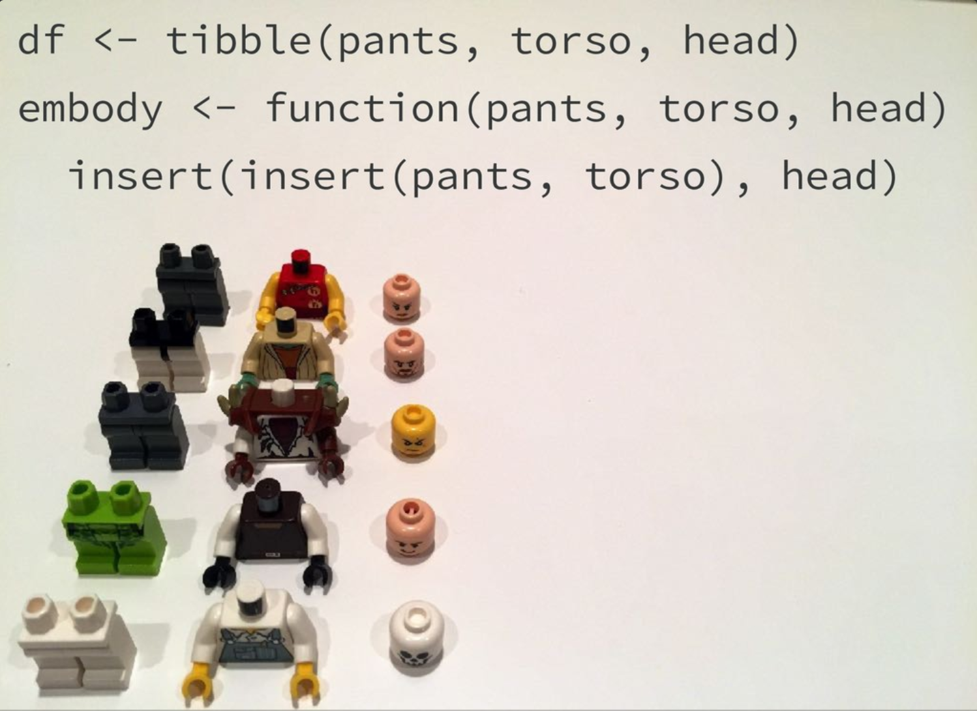
https://speakerdeck.com/jennybc/purrr-workshop

Slide 115
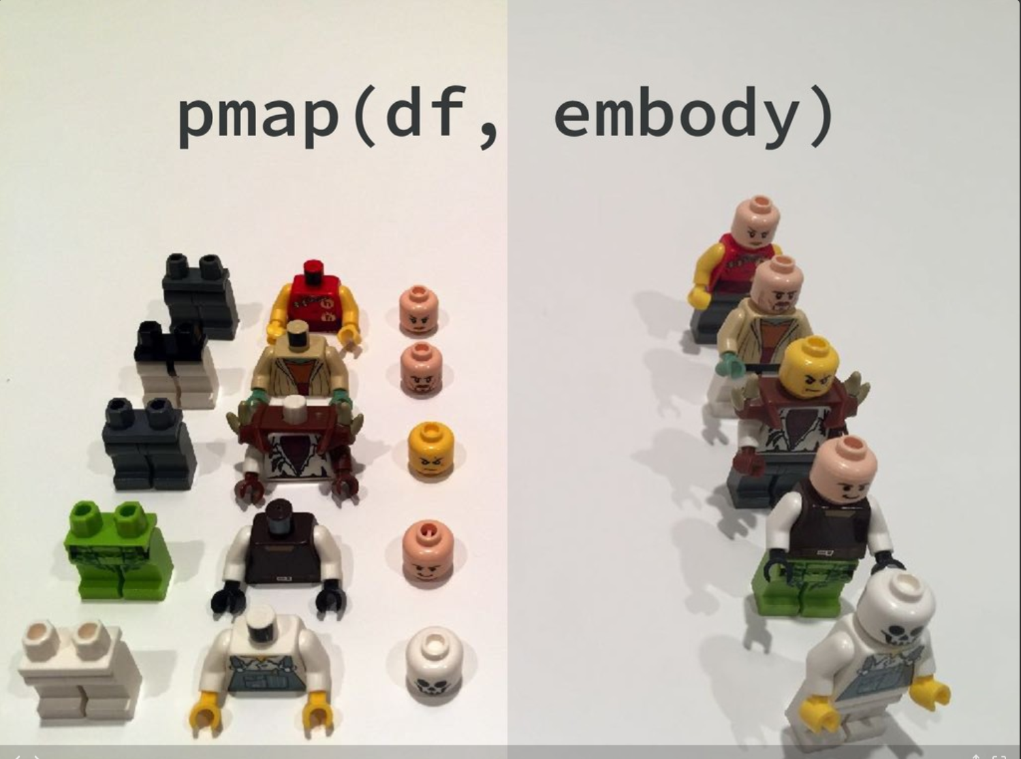
https://speakerdeck.com/jennybc/purrr-workshop

Slide 116
walk(), walk_2(), and pwalk()
Versions of map(), map2(), and pmap() that do not return results. These are for triggering side effects (like writing files or saving graphs).
CC BY-SA RStudio

Slide 117
map and walk functions
single list | two lists | n lists | returns results as
map() | map2() | pmap() | list
map_chr() | map2_chr() | pmap_chr() | character vector
map_dbl() | map2_dbl() | pmap_dbl() | double vector (numeric)
map_int() | map2_int() | pmap_int() | integer vector
map_lgl() | map2_lgl() | pmap_lgl() | logical vector
map_df() | map2_df() | pmap_df() | data frame
walk() | walk2() | pwalk() | side effect
CC BY-SA RStudio

Slide 118
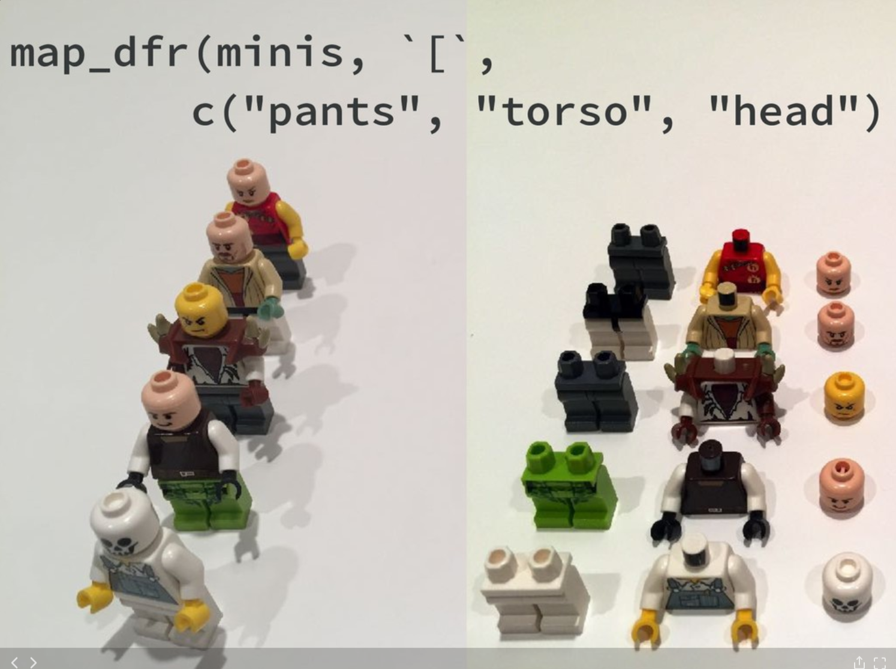
https://speakerdeck.com/jennybc/purrr-workshop

Slide 119
Practice

Slide 120
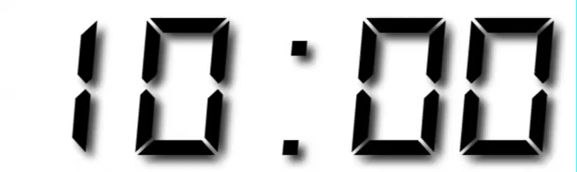
Your Turn
Use rnorm() and a map function to make test results for three students. Save the result as tests.
Student 1 has 5 tests with a mean of 70 and a sd of 20
Student 2 has 5 tests with a mean of 80 and a sd of 15
Student 3 has 5 tests with a mean of 90 and a sd of 15
Use runif() and a map to make homework results for the students. Save the result as homeworks.
Student 1 has 5 homeworks with a min of 80 and a max of 95
Student 2 has 6 homeworks with a min of 75 and a max of 90
Student 3 has 7 homeworks with a min of 70 and a max of 100
Compute the grade for each student a student's grade is 0.8 * the average test score plus 0.2 * the average homework score. Save the result as grades.
Use purrr functions and tibble() to turn each element of grades into a tibble with one row and one column. Then use a purrr function and write_csv() to save the tibbles to your working directory as "student1.csv", "student2.csv", "student3.csv".

Slide 121
tests <-
map2(list(70, 80, 90), list(20, 15, 15), rnorm, n = 5)
homeworks <-
list(n = list(5, 6, 7),
min = list(80, 75, 70),
max = list(95, 90, 100)) %>%
pmap(runif)
grades <-
map2(tests, homeworks,
function(x, y) .8 * mean(x) + .2 * mean(y))
CC BY-SA RStudio

Slide 122
filenames <-
list("student1.csv",
"student2.csv",
"student3.csv")
grades %>%
map(tibble) %>%
walk2(filenames, write_csv)
CC BY-SA RStudio

Slide 123
List columns

Slide 124
Quiz
If you one of the elements of a list can be another list,
can one of the columns of a data frame be another list?
List
data frame
1
2
3
double
?
num | cha | listcol
1 | "one" | 1
2 | "two" | c("1", "two", "FALSE")
3 | "three" | FALSE
=
"one"
"two"
"three"
character
1
double
"1"
"two"
"FALSE"
character
list
FALSE
logical

Slide 125
Yes.
tibble(
num = c(1, 2, 3),
cha = c("one", "two", "three"),
listcol = list(1, c("1", "two", "FALSE"), FALSE)
)
# A tibble: 3 × 3
num cha listcol
<dbl> <chr> <list>
1 1 one <dbl [1]>
2 2 two <chr [3]>
3 3 three <lgl [1]>
CC BY-SA RStudio

Slide 126
But WHY?
Example uses:
Simulation scenarios & inputs: list column = simulated data
Modelling grouped data: list column = model outputs

